Slide 1
Electronic Devices and Circuits Lecture-5
CSE 223
Prepared by
Ipshita Tasnim Raha
Lecturer (Provisional)
Dept. of CSE
Varendra University

Slide 2
Introduction to
Bipolar Junction Transistor
(BJT)

Slide 3
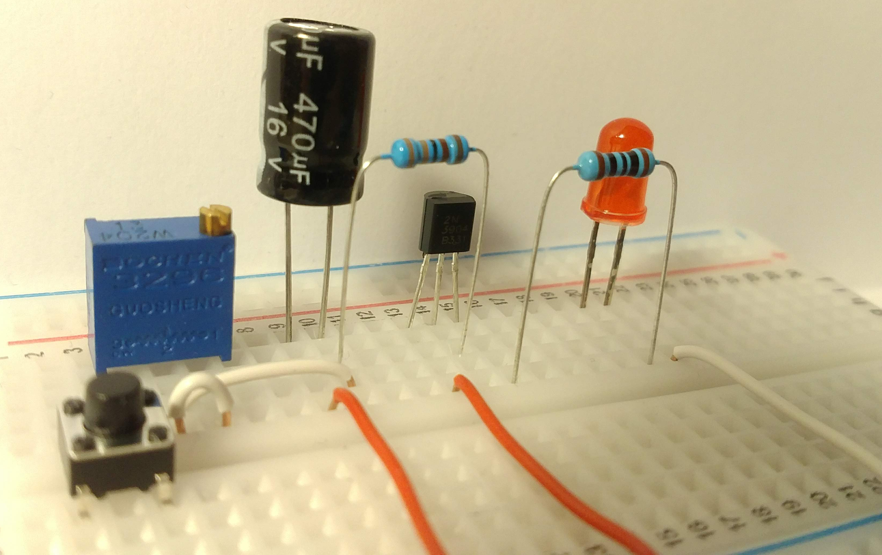
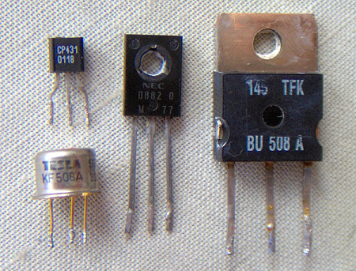
Transistor
A transistor consists of two p-n junctions formed by sandwiching either p-type or n-type semiconductor between a pair of opposite types.
There are two types of transistors. They are:
n-p-n transistor
p-n-p transistor
Prepared by Ipshita Tasnim Raha

Slide 4
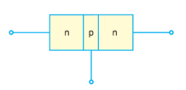

Bipolar Junction Transistor (BJT)
An n-p-n transistor is composed of two n-type semiconductors separated by a thin section of p-type
A p-n-p transistor is formed by two p-sections separated by a thin section of n-type.
Prepared by Ipshita Tasnim Raha

Slide 5
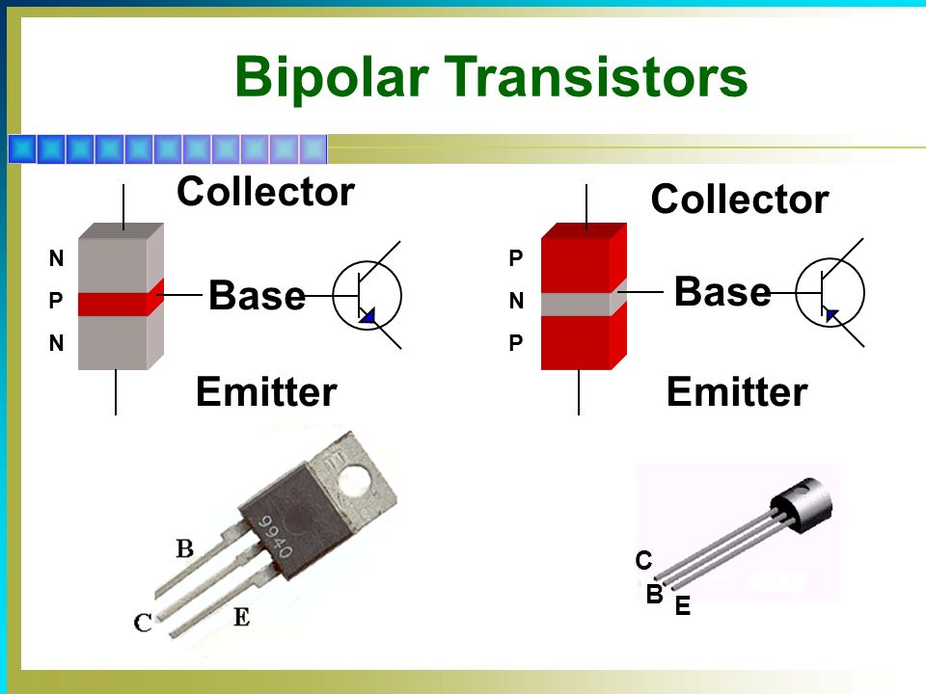
Bipolar Junction Transistor (BJT)
In each type of transistor, the following points are noted:
These are two p-n junctions. Therefore, a transistor may be regarded as a combination of two diodes connected back to back.
There are three terminals, one taken from each type of semiconductor.
The middle section is a very thin layer. This is the most important factor in the function of a transistor.
A transistor (p-n-p or n-p-n) has three sections of doped semiconductors. The section on one side is the emitter and the section on the opposite side is the collector. The middle section is called the base and forms two junctions between the emitter and collector.
Prepared by Ipshita Tasnim Raha

Slide 6
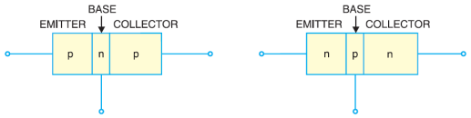
Bipolar Junction Transistor (BJT)
The transistor has two p-n junctions that is it is like two diodes. The junction between emitter and base is called emitter-base diode or simply the emitter diode. The junction between the base and collector is called collector-base diode or simply collector diode. The emitter diode is always forward biased whereas collector diode is always reverse biased.
Prepared by Ipshita Tasnim Raha

Slide 7
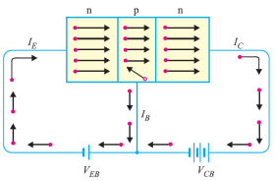
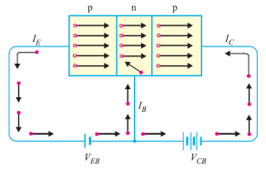
Bipolar Junction Transistor (BJT)
Prepared by Ipshita Tasnim Raha

Slide 8
Terminals of BJT
Emitter: The section on one side that supplies charge carriers (electrons or holes) is called the emitter. The emitter is always forward biased with respect to base so that it can supply a large number of majority carriers. In the first figure, the emitter of p-n-p transistor is forward biased and supplies hole charges to its junction with the base. Similarly, in the second figure, the emitter of n-p-n transistor has a forward bias and supplies free electrons to its junction with the base.
Collector: The section on the other side that collects the charges is called the collector. The collector is always reverse biased. Its function is to remove charges from its junction with the base. In the first figure, the collector of p-n-p transistor has a reverse bias and receives hole charges that flow in the output circuit. Similarly, in the second figure, the collector of n-p-n transistor has reverse bias and receives electrons.
Base: The middle section which forms two p-n junctions between the emitter and collector is called the base. The base-emitter junction is forward biased, allowing low resistance for the emitter circuit. The base-collector junction is reverse biased and provides high resistance in the collector circuit.
Prepared by Ipshita Tasnim Raha

Slide 9
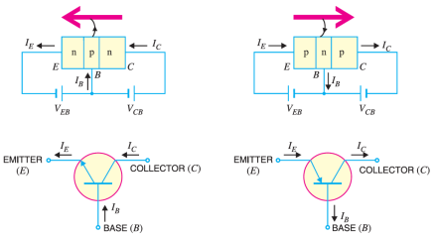
Symbol of BJT
The symbols used for n-p-n and p-n-p transistors are given below,
Prepared by Ipshita Tasnim Raha

Slide 10
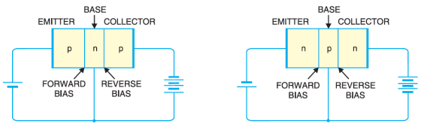
Working of n-p-n transistor:
Following figure shows the n-p-n transistor with forward bias to emitter - base junction and reverse bias to collector - base junction.
The forward bias causes the electrons in the n-type emitter to flow towards the base. This constitutes the emitter current I_{E}. As these electrons flow through the p-type base, they tend to combine with holes.
As the base is lightly doped and very thin, therefore, only a few electrons (less than 5%) combine with holes to constitute base current I_{B}. The remainder (more than 95%) cross over into the collector region to constitute collector current I_{C}.
In this way, almost the entire emitter current flows in the collector circuit. It is clear that emitter current is the sum of collector and base currents.
That is, I_{E} = I_{B} + I_{C}
Prepared by Ipshita Tasnim Raha

Slide 11
Working of p-n-p transistor:
Following figure shows the basic connection of a p-n-p transistor.
The forward bias causes the holes in the p-type emitter to flow towards the base. This constitutes the emitter current I_{E}. As these holes cross into n-type base, they tend to combine with the electrons.
As the base is lightly doped and very thin, therefore, only a few holes (less than 5%) combine with the electrons. The remainder (more than 95%) cross into the collector region to constitute collector current I_{C}.
In this way, almost the entire emitter current flows in the collector circuit. It may be noted that current conduction within p-n-p transistor is by holes. However, in the external connecting wires, the current is still by electrons.
Prepared by Ipshita Tasnim Raha

Slide 12
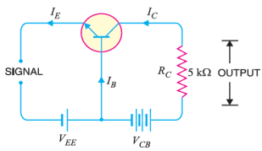
Transistor as amplifier:
A transistor raises the strength of a weak signal and thus acts as an amplifier.
The given circuit is the basic circuit of a transistor amplifier. The weak signal is applied between emitter – base junction and output is taken across the load RC connected in the collector circuit.
In order to achieve faithful amplification, the input circuit should always remain forward biased. To do so, a DC voltage V_{EE} is applied in the input circuit in addition to the signal as shown.
Prepared by Ipshita Tasnim Raha

Slide 13
Transistor as amplifier:
This DC voltage is known as bias voltage and its magnitude is such that it always keeps the input circuit forward biased regardless of the polarity of the signal.
As the input circuit has low resistance, therefore, a small change in signal voltage causes an appreciable change in emitter current. This causes almost the same change in collector current due to transistor action.
The collector current flowing through a high load resistance RC produces a large voltage across it.
Thus, a weak signal applied in the input circuit appears in the amplified form in the collector circuit. It is in this way that a transistor acts as an amplifier.
Prepared by Ipshita Tasnim Raha

Slide 14
Transistor Connections
There are three leads in a transistor emitter, base and collector terminals. However, when a transistor is to be connected in a circuit, we require four terminals, two for the input and two for the output.
This difficulty is overcome by making one terminal of the transistor common to both input and output terminals.
The input is fed between this common terminal and one of the other two terminals. The output is obtained between the common terminal and the remaining terminal.
A transistor can be connected in a circuit in the following three ways: 1. Common base connection 2. Common emitter connection 3. Common collector connection
Each circuit connection has specific advantages and disadvantages.
Prepared by Ipshita Tasnim Raha

Slide 15
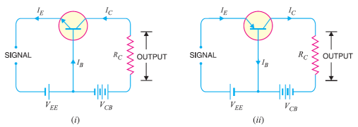
Common Base Connection:
In this circuit arrangement, input is applied between emitter and base and output is taken from collector and base. Here, base of the transistor is common to both input and output circuits and hence the name common base connection.
Fig: (i) common base n-p-n transistor (ii) shows the common base p-n-p transistor circuit.
Prepared by Ipshita Tasnim Raha

Slide 16

Current amplification factor (α)
It is the ratio of output current to input current.
In a common base connection, the input current is the emitter current I_{E} and output current is the collector current I_{C}.
So we can write,
Prepared by Ipshita Tasnim Raha

Slide 17
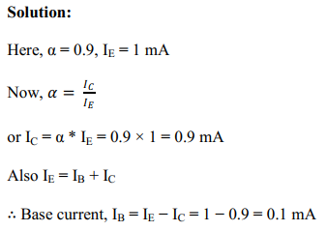
Math Problems
Example 1: In a common base connection, current amplification factor is 0.9. If the emitter current is 1mA, determine the value of base current.
Prepared by Ipshita Tasnim Raha

Slide 18
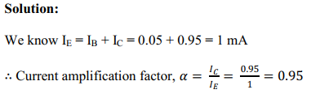
Math Problems
Example 2: In a common base connection, IC = 0.95 mA and IB = 0.05 mA. Find the value of α.
Prepared by Ipshita Tasnim Raha

Slide 19
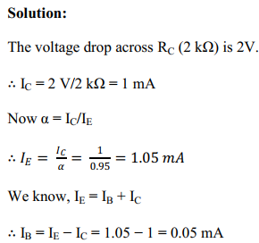
Math Problems
Example 3: In a common base connection, α = 0.95. The voltage drop across 2 kΩ resistance which is connected in the collector is 2V. Find the base current.
Prepared by Ipshita Tasnim Raha

Slide 20
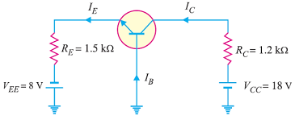
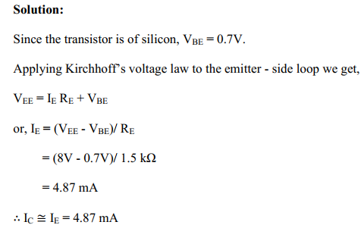
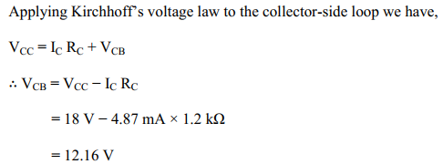
Math Problems
Example 4: For the common base circuit shown in the figure, determine IC and VCB. Assume the transistor to be of silicon.
Prepared by Ipshita Tasnim Raha

Slide 21
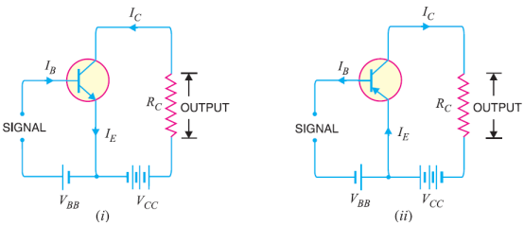
Common Emitter Connection
In this circuit arrangement, input is applied between base and emitter and output is taken from the collector and emitter. Here, emitter of the transistor is common to both input and output circuits and hence the name common emitter connection.
Fig: (i) common emitter n-p-n transistor circuit (ii) common emitter p-n-p transistor circuit
Prepared by Ipshita Tasnim Raha

Slide 22

Base curent amplification factor (β)
In common emitter connection, input current is IB and output current is IC.
The ratio of change in collector current to the change in base current is known as base current amplification factor.
That is,
Prepared by Ipshita Tasnim Raha

Slide 23
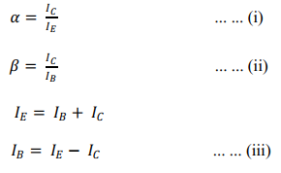

Relation between β and α
A simple relation exists between β and α. This can be derived as follows :
So,
From (ii) and (iii) we can write,
Prepared by Ipshita Tasnim Raha

Slide 24


Relation between β and α
Dividing the numerator and denominator of R.H.S. of (iv) by IE, we get,
From (i) we can write,
Prepared by Ipshita Tasnim Raha

Slide 25
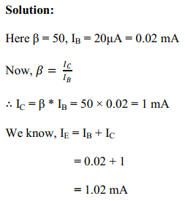
Math Problems
Example 1: Calculate IE in a transistor for which β = 50 and IB = 20 μA.
Prepared by Ipshita Tasnim Raha

Slide 26
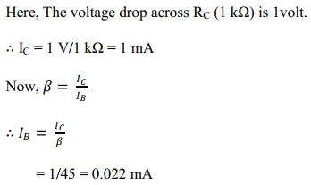
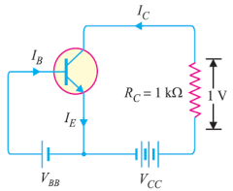
Math Problems
Example 2: For a transistor, β = 45 and voltage drop across 1kΩ which is connected in the collector circuit is 1 volt. Find the base current for common emitter connection.
Solution:
Prepared by Ipshita Tasnim Raha

Slide 27
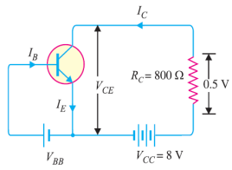
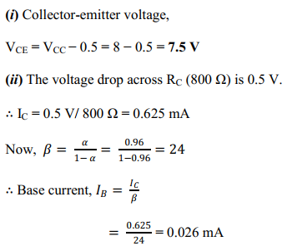
Math Problems
Example 3: A transistor is connected in common emitter (CE) configuration in which collector supply is 8V and the voltage drop across resistance RC connected in the collector circuit is 0.5V. The value of RC = 800 Ω. If α = 0.96, determine: (i) collector-emitter voltage (ii) base current
Solution:
Prepared by Ipshita Tasnim Raha

Slide 28
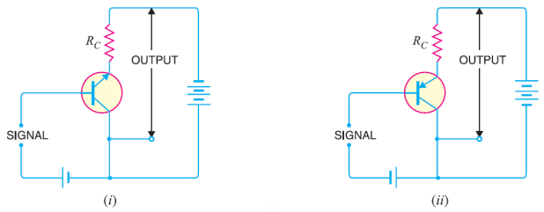
Common Collector Connection:
In this circuit arrangement, input is applied between base and collector while output is taken between the emitter and collector. Here, collector of the transistor is common to both input and output circuits and hence the name common collector connection.
Fig: (i) common collector n-p-n transistor circuit (ii) common collector p-n-p circuit
Prepared by Ipshita Tasnim Raha

Slide 29

Current amplification factor (γ)
In common collector circuit, input current is the base current IB and output current is the emitter current IE.
The ratio of change in emitter current to the change in base current is known as current amplification factor in common collector arrangement.
That is,
Prepared by Ipshita Tasnim Raha

Slide 30
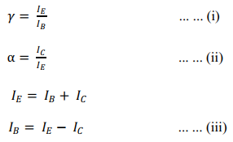

Relation between γ and α
A simple relation exists between β and α. This can be derived as follows :
So,
From (ii) and (iii) we can write,
Prepared by Ipshita Tasnim Raha

Slide 31


Relation between γ and α
Dividing the numerator and denominator of R.H.S. of (iv) by IE, we get,
From (i) we can write,
Prepared by Ipshita Tasnim Raha

Slide 32
BJT operation modes
The transistor can be operated in three modes: 1. Cut-off mode 2. Saturation mode 3. Active mode
In order to operate transistor in one of these regions, we have to supply dc voltage to the n-p-n or p-n-p transistor.
Based on the polarity of the applied dc voltage, the transistor operates in any one of these regions. Applying dc voltage to the transistor is nothing but the biasing of transistor
Prepared by Ipshita Tasnim Raha

Slide 33
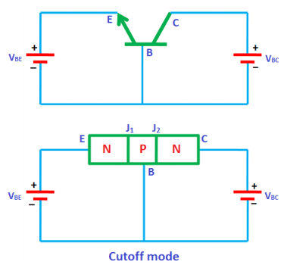
Cut-off mode
In the cut-off mode, both the junctions of the transistor (emitter to base and collector to base) are reverse biased.
In other words, if we assume two p-n junctions as two p-n junction diodes, both the diodes are reverse biased in cutoff mode. We know that in reverse bias condition, no current flows through the device. Hence, no current flows through the transistor. Therefore, the transistor is in off state and acts like an open switch.
The cutoff mode of the transistor is used in switching operation for switch OFF application.
Prepared by Ipshita Tasnim Raha

Slide 34
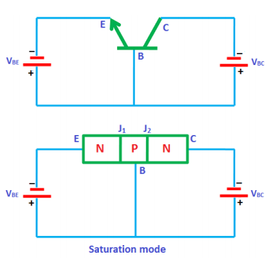
Saturation mode
In the saturation mode, both the junctions of the transistor (emitter to base and collector to base) are forward biased. In other words, if we assume two p-n junctions as two p-n junction diodes, both the diodes are forward biased in saturation mode. We know that in forward bias condition, current flows through the device. Hence, electric current flows through the transistor.
In saturation mode, free electrons (charge carriers) flows from emitter to base as well as from collector to base. As a result, a huge current will flow to the base of transistor. Therefore, the transistor in saturation mode will be in ON state and acts like a closed switch.
The saturation mode of the transistor is used in switching operation for switch ON application. From the above discussion, we can say that by operating the transistor in saturation and cutoff region, we can use the transistor as an ON/OFF switch.
Prepared by Ipshita Tasnim Raha

Slide 35
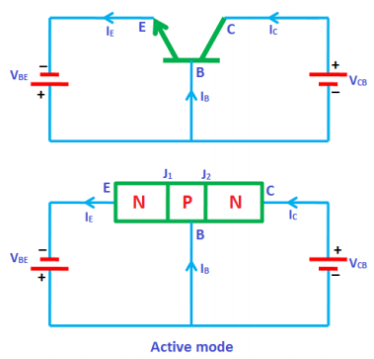
Active mode
In the active mode, one junction (emitter to base) is forward biased and another junction (collector to base) is reverse biased. In other words, if we assume two p-n junctions as two p-n junction diodes, one diode will be forward biased and another diode will be reverse biased.
The active mode of operation is used for the amplification of current.
From the above discussion, we can say that the transistor works as an ON/OFF switch in saturation and cutoff modes whereas it works as an amplifier of current in active mode.
Prepared by Ipshita Tasnim Raha

Slide 36
Time is relative,
Its only worth depends upon
what we do as it’s passing
- Albert Einstein

Slide 37
Thanks!
Any questions?

